Slide 1
Data Mining for Business
Instance based Learning
k nearest neighbor
Dr. Kamesam

Slide 2
Different Learning Methods
Eager Learning
Explicit description of target function on the whole training set
Most of the classification methods we learn except today
Instance-based Learning
Learning=storing all training instances
Classification=assigning target function to a new instance
Referred to as “Lazy” learning
Note that all the work is done when a test record is to be classified

Slide 3
Nearest Neighbor Classifier
Basic idea:
If it walks like a duck, quacks like a duck, then it’s probably a duck
Compute Distance
Test Record
Training Records
Choose k of the “nearest” records

Slide 4
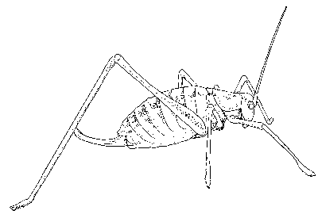

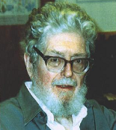
Nearest Neighbor Classifier
10
9
8
7
Evelyn Fix
1904-1965
Joe Hodges
1922-2000
6
Antenna Length
5
If the nearest instance to the previously unseen instance is a Katydid
class is Katydid
else
class is Grasshopper
4
3
2
1
Katydids
Grasshoppers
1
2
3
4
5
6
7
8
9
10
Abdomen Length

Slide 5
Nearest-Neighbor Classifiers
Requires three things
The set of stored records
Distance metric to compute distance between records
The value of k, the number of nearest neighbors to retrieve
To classify an unknown record:
Compute distance to other training records
Identify k nearest neighbors
Use class labels of nearest neighbors to determine the class label of unknown record (e.g., by taking majority vote)

Slide 6

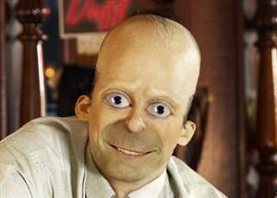
Similarity and Distance
One of the fundamental concepts of data mining is the notion of similarity between data points, often formulated as a numeric distance between data points.
Similarity is the basis for many data mining procedures.
We learned a bit about similarity when we discussed data
We will consider the most direct use of similarity today.
Later we will see it again (for clustering)

Slide 7
KNN learning
Assumes X = n-dim. space
discrete or continuous f(x)
Let
x = <a₁(x),…,a_{n}(x)>
d(x_{i},x_{j}) = Euclidean distance
Algorithm (given new x)
find k nearest stored x_{i} (use d(x, x_{i}))
take the most common value of f
Usually k is chosen to be odd, then use majority rule

Slide 8
Similarity/Distance Between Data Items
Each data item is represented with a set of attributes (consider them to be numeric for the time being)
“Closeness” is defined in terms of the distance (Euclidean or some other distance) between two data items.
The Euclidean distance between X_{i}=<a₁(X_{i}),…,a_{n}(X_{i})> and X_{j}= <a₁(X_{j}),…,a_{n}(X_{j})> is defined as:
Distance(John, Rachel) = sqrt[(35-22)²+(35K-50K)²+(3-2)²]
John:
Age = 35
Income = 35K
No. of credit cards = 3
Rachel:
Age = 22
Income = 50K
No. of credit cards = 2

Slide 9
Up to now we have assumed that the nearest neighbor algorithm uses the Euclidean Distance, however this need not be the case…
10
9
Max (p=inf)
8
7
6
Manhattan (p=1)
5
4
Weighted Euclidean
3
2
1
Mahalanobis
1
2
3
4
5
6
7
8
9
10

Slide 10
Other Distance Metrics
Mahalanobis distance
Scale-invariant metric that normalizes for variance.
Cosine Similarity
Cosine of the angle between the two vectors.
Used in text and other high-dimensional data.
Pearson correlation
Standard statistical correlation coefficient.
Used for bioinformatics data.
Edit distance
Used to measure distance between unbounded length strings.
Used in text and bioinformatics.
http://nlp.stanford.edu/IR-book/html/htmledition/edit-distance-1.html

Slide 11

Euclidean, Minkowski, Mahalanobis distances
Euclidean
Minkowski
Mahalanobis

Slide 12
…In fact, we can use the nearest neighbor algorithm with any distance/similarity function
Edit distance: the minimum #operations required to change one string to another
For example, is “Faloutsos” Greek or Irish? We could compare the name “Faloutsos” to a database of names using string edit distance…
edit_distance(Faloutsos, Keogh) = 8
edit_distance(Faloutsos, Gunopulos) = 6
Hopefully, the similarity of the name (particularly the suffix) to other Greek names would mean the nearest nearest neighbor is also a Greek name.
ID | Name | Class
1 | Gunopulos | Greek
2 | Papadopoulos | Greek
3 | Kollios | Greek
4 | Dardanos | Greek
5 | Keogh | Irish
6 | Gough | Irish
7 | Greenhaugh | Irish
8 | Hadleigh | Irish
Specialized distance measures exist for DNA strings, time series, images, graphs, videos, sets, fingerprints etc…

Slide 13

k-Nearest Neighbor Algorithms (a.k.a. Instance-based learning (IBL), Memory-based learning)
No model is built: Store all training examples
Any processing is delayed until a new instance must be classified → lazy classification technique
No response
Response
No response
Response
Class: ?
No response

Slide 14
Data Normalization
Since we are computing Euclidian distance, it is important to Normalize the data on all continuous attributes .
KNN algorithm in SPSS Modeler gives you the option of asking for Data Normalization
Categorical Variables need to be encoded with dummy variables (as in the gender discrimination data set)

Slide 15

k-Nearest Neighbor Classifier Example (k=1)
Customer | Age | Income (K) | No. of cards | Response
John | 35 | 35 | 3 | Yes
Rachel | 22 | 50 | 2 | No
Ruth | 63 | 200 | 1 | No
Tom | 59 | 170 | 1 | No
Neil | 25 | 40 | 4 | Yes
David | 37 | 50 | 2 | ?
Distance from David
sqrt [(35-37)²+(35-50) ² +(3-2) ²]=15.16
sqrt [(22-37)²+(50-50)² +(2-2)²]=15
sqrt [(63-37) ²+(200-50) ² +(1-2) ²]=152.23
sqrt [(59-37) ²+(170-50) ² +(1-2) ²]=122
sqrt [(25-37) ²+(40-50) ² +(4-2) ²]=15.74
sqrt [(35-37)²+(35-50) ²
+(3-2) ²]=15.16
sqrt [(22-37)²+(50-50)²
+(2-2)²]=15
sqrt [(25-37) ²+(40-50) ²
+(4-2) ²]=15.74
No
Notes:
K是Neighbor点的个数

Slide 16
k-Nearest Neighbor Classifier Example (k=3)
Customer | Age | Income (K) | No. of cards | Response
John | 35 | 35 | 3 | Yes
Rachel | 22 | 50 | 2 | No
Ruth | 63 | 200 | 1 | No
Tom | 59 | 170 | 1 | No
Neil | 25 | 40 | 4 | Yes
David | 37 | 50 | 2 | ?
Distance from David
sqrt [(35-37)²+(35-50) ² +(3-2) ²]=15.16
sqrt [(22-37)²+(50-50)² +(2-2)²]=15
sqrt [(63-37) ²+(200-50) ² +(1-2) ²]=152.23
sqrt [(59-37) ²+(170-50) ² +(1-2) ²]=122
sqrt [(25-37) ²+(40-50) ² +(4-2) ²]=15.74
sqrt [(35-37)²+(35-50) ²
+(3-2) ²]=15.16
sqrt [(22-37)²+(50-50)²
+(2-2)²]=15
sqrt [(25-37) ²+(40-50) ²
+(4-2) ²]=15.74
Yes

Slide 17
Nearest Neighbors for Classification k = 3
To determine the class of a new example E:
Calculate the distance between E and all examples in the training set
Select k examples closest to E in the training set
Assign E to the most common class (or some other combining function) among its k nearest neighbors
No response
Response
No response
Response
Class: Response
No response

Slide 18
Train vs. Test
In the previous example, number of test records = 1.
In general, if you are going to build a KNN model, you should partition into test/train, and use the test data for assessing the model.

Slide 19
Strengths and Weaknesses
Strengths:
Simple to implement and use
Comprehensible – easy to explain prediction
Robust to noisy data by averaging k-nearest neighbors
Distance function can be tailored using domain knowledge
Can learn complex decision boundaries
Much more expressive than linear classifiers & decision trees
More on this later
Weaknesses: (the first two are usually NOT an issue )
Need a lot of space to store all examples
Takes much more time to classify a new example than other models (need to compare distance to all other examples)
Distance function must be designed carefully with domain knowledge

Slide 20
Strengths and Weaknesses I
John:
Age = 35
Income = 35K
No. of credit cards = 3
Rachel:
Age = 22
Income = 50K
No. of credit cards = 2
Distance(John, Rachel) = sqrt[(35-22)²+(35,000-50,000)²+(3-2)²]
Distance between neighbors can be dominated by an attribute with relatively large values (e.g., income in our example).
Important to normalize (e.g., normaize attribute values to [ 0, 1]
y_{i} = (X_{i} – min_{i} ) / (max _{I} - min _{I} )
One could also use (x-mean)/sd

Slide 21
The nearest neighbor algorithm is sensitive to the units of measurement
X axis measured in centimeters
Y axis measure in dollars
The nearest neighbor to the pink unknown instance is red.
X axis measured in millimeters
Y axis measure in dollars
The nearest neighbor to the pink unknown instance is blue.
One solution is to normalize the units to pure numbers. Typically the features are Z-normalized to have a mean of zero and a standard deviation of one. X = (X – mean(X))/std(x)

Slide 22
Data Normalization

Slide 23
Strengths and Weaknesses II
Distance works naturally with numerical attributes
Distance(John, Rachel) = sqrt[(35-22)²+(35,000-50,000)²+(3-2)²] = 15.16
What if we have nominal/categorical attributes?
Example: married
Customer | Married | Income (K) | No. of cards | Response
John | Yes | 35 | 3 | Yes
Rachel | No | 50 | 2 | No
Ruth | No | 200 | 1 | No
Tom | Yes | 170 | 1 | No
Neil | No | 40 | 4 | Yes
David | Yes | 50 | 2 | ?

Slide 24
Recall: Geometric interpretation of classification models
Age
+
+
+
+
+
+
+
+
+
+
+
+
+
+
+
45
50K
Balance
Bad risk (Default) – 16 cases
Good risk (Not default) – 14 cases
+

Slide 25
How does a 1-nearest-neighbor classifier partition the space?
Very different boundary (in comparison to what we have seen)
Very tailored to the data that we have
Nothing is ever wrong on the training data
Maximal overfitting
Age
+
+
+
+
+
+
+
+
+
+
+
+
+
+
+
45
50K
Balance
Bad risk (Default) – 16 cases
Good risk (Not default) – 14 cases
+

Slide 26
k-Nearest Neighbor Classification (kNN)
Unlike all the previous learning methods, kNN does not build model from the training data.
To classify a test instance d, define k-neighborhood P as k nearest neighbors of d
Count number n of training instances in P that belong to class c_{j}
Estimate Pr(c_{j}|d) as n/k
No training is needed. Classification time is linear in training set size for each test case.

Slide 27
SPSS MODELER DEMO

Slide 28
Instance-Based Classifiers
Examples:
Rote-learner
Memorizes entire training data and performs classification only if attributes of record exactly match one of the training examples
No generalization
K-Nearest neighbor
Uses k “closest” points (nearest neighbors) for performing classification
Generalizes

Slide 29
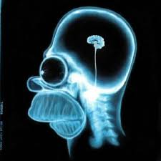

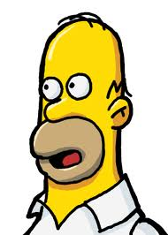
Are These Similar at All?
Humans would say “yes” although not perfectly so (both Homer)
Nearest Neighbor method without carefully crafted features would say “no’” since the colors and other superficial aspects are completely different. Need to focus on the shapes.
Notice how humans find the image to the right to be a bad representation of Homer even though it is a nearly perfect match of the one above.

Slide 30
Curse of Dimensionality
Distance usually relates to all the attributes and assumes all of them have the same effects on distance
Wrong classification due to presence of many irrelevant attributes is often termed as the curse of dimensionality
For example
If each instance is described by 20 attributes out of which only 2 are relevant in determining the classification of the target function.
Then instances that have identical values for the 2 relevant attributes may nevertheless be distant from one another in the 20dimensional instance space.

Slide 31
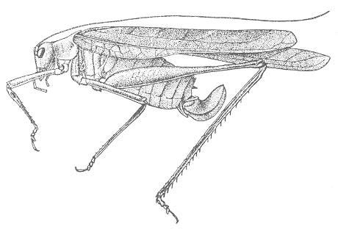
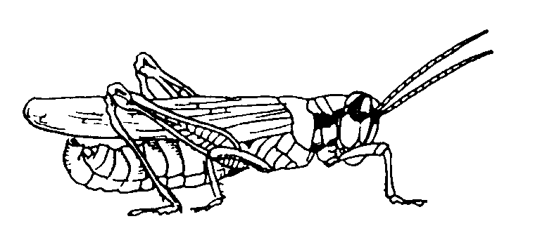
The nearest neighbor algorithm is sensitive to irrelevant features…
Suppose the following is true, if an insects antenna is longer than 5.5 it is a Katydid, otherwise it is a Grasshopper.
Using just the antenna length we get perfect classification!
Training data
1
2
3
4
5
6
7
8
9
10
6
1
2
3
4
5
6
7
8
9
10
1
2
3
4
5
6
7
8
9
10
5
10
Suppose however, we add in an irrelevant feature, for example the insects mass.
Using both the antenna length and the insects mass with the 1-NN algorithm we get the wrong classification!
9
8
7
6
5
4
3
2
1
1
2
3
4
5
6
7
8
9
10
1
2
3
4
5
6
7
8
9
10

Slide 32
How do we Mitigate Irrelevant Features?
Use more training instances
Ask an expert what features are relevant
Use statistical tests
Search over feature subsets

Slide 33
Nearest Neighbor Variations
Can be used to estimate the value of a real-valued function (regression) by taking the average function value of the k nearest neighbors to an input point.
All training examples can be used to help classify a test instance by giving every training example a vote that is weighted by the inverse square of its distance from the test instance.

Slide 34
Why Searching over Feature Subsets is Hard
Suppose you have the following classification problem, with 100 features. Features 1 and 2 (the X and Y below) give perfect classification, but all 98 of the other features are irrelevant…
Only Feature 2
Only Feature 1
Using all 100 features will give poor results, but so will using only Feature 1, and so will using Feature 2! Of the 2¹⁰⁰ –1 possible subsets of the features, only one really works.

Slide 35
Example: k=6 (6NN)
Government
Science
Arts
A new point
Pr(science| )?

Slide 36
kNN - Important Details
kNN estimates the value of the target variable by some function of the values for the k-nearest neighbors. The simplest techniques are:
for classification: majority vote
for regression: mean/median/mode
for class probability estimation: fraction of positive neighbors
For all of these cases, it may make sense to create a weighted average based on the distance to the neighbors, so that closer neighbors have more influence in the estimation.

Slide 37
Case-based Reasoning (CBR)
CBR is similar to instance-based learning
But may reason about the differences between the new example and match example
CBR Systems are used a lot
help-desk systems
legal advice
planning & scheduling problems
Next time you are on the help with tech support
The person maybe asking you questions based on prompts from a computer program that is trying to most efficiently match you to an existing case!

Slide 38
We can speed up nearest neighbor algorithm by “throwing away” some data. This is called data editing.
Note that this can sometimes improve accuracy!
We can also speed up classification with indexing
One possible approach. Delete all instances that are surrounded by members of their own class.

Slide 39
Feature Relevance and Weighting
Standard distance metrics weight each feature equally when determining similarity.
Problematic if many features are irrelevant, since similarity along many irrelevant examples could mislead the classification.
Features can be weighted by some measure that indicates their ability to discriminate the category of an example, such as information gain.
Overall, instance-based methods favor global similarity over concept simplicity.
+
Training
Data
–
+
Test Instance
??

Slide 40
We can visualize the nearest neighbor algorithm in terms of a decision surface…
Note the we don’t actually have to construct these surfaces, they are simply the implicit boundaries that divide the space into regions “belonging” to each instance.
Although it is not necessary to explicitly calculate these boundaries, the learned classification rule is based on regions of the feature space closest to each training example.
This division of space is called Dirichlet Tessellation (or Voronoi diagram, or Theissen regions).

Slide 41
The nearest neighbor algorithm is sensitive to outliers…
The solution is to…

Slide 42
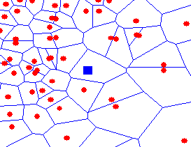
We can generalize the nearest neighbor algorithm to the k- nearest neighbor (kNN) algorithm.
We measure the distance to the nearest k instances, and let them vote. k is typically chosen to be an odd number.
k – complexity control for the model
K = 1
K = 3

